Slide 1

Rural Economic Development
Loan and Grant Program
REDLG

Slide 2
Who may apply to this program?
All rural electric cooperatives in Alabama
A borrower with an outstanding loan with the USDA Rural Utilities Service (RUS)
A former borrower of USDA RUS
A nonprofit utility that was never a borrower of RUS, but would be eligible to become one (municipal electric)

Slide 3
Rural Economic Development
Loan and Grant Program
REDLG
Rural Economic Development Loan
Rural Economic Development Grant

Slide 4
USDA RUS Eligible Applicant/Borrower
“Intermediary”
Project
“Ultimate Recipient”
Eligible Location
“Rural Areas with Populations <50,000”
Application Funding
“Nationally Competitive – Monthly”

Slide 5
REDL or “Pass Through” Loan
Rural Electric Cooperative borrows from USDA at
0% interest 10 years
Rural Electric Cooperative loans to ultimate recipient at 0% interest

Slide 6
Eligible Uses of Loan Funds
  Startup venture costs which may include real estate, buildings, equipment, and working capital
  Business expansion
  Business incubators
  Technical Assistance
  Project Feasibility Studies

Slide 7

USDA Grant for Revolving Loan Fund: Initial Loan
$300,000 Grant
Rural Electric Cooperative establishes RLF $360,000
Intermediary provides 20% match $60,000

Slide 8
Eligible Uses of GRANT funds for Revolving Loan Fund “Initial Loan”
Community Development Projects
Community Facility Projects
Business Incubators
Facilities and equipment for education and training to facilitate economic development
Medical facilities or equipment
Telecom or computer network for medical or educational services or job training

Slide 9

Rural Development
Project Examples
from
REDLG Portfolio

Slide 10
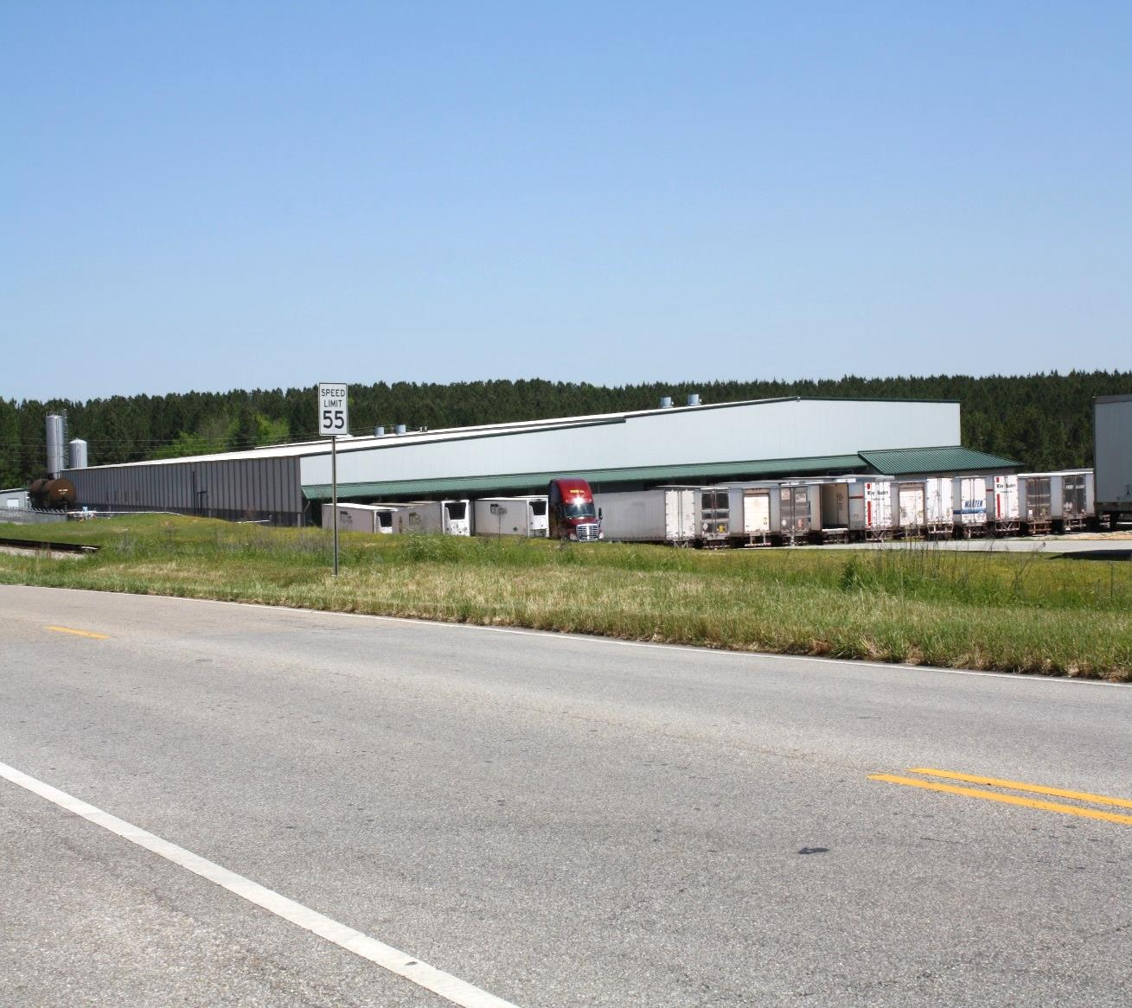
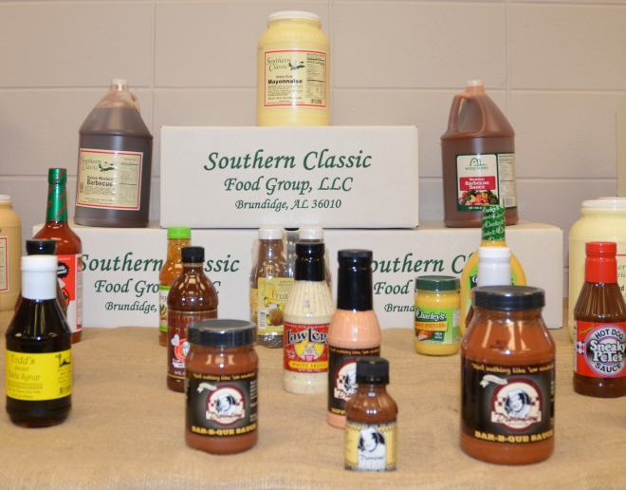
South Alabama EC
Brundidge Industrial Development Board
Southern Classic Food Group

Slide 11
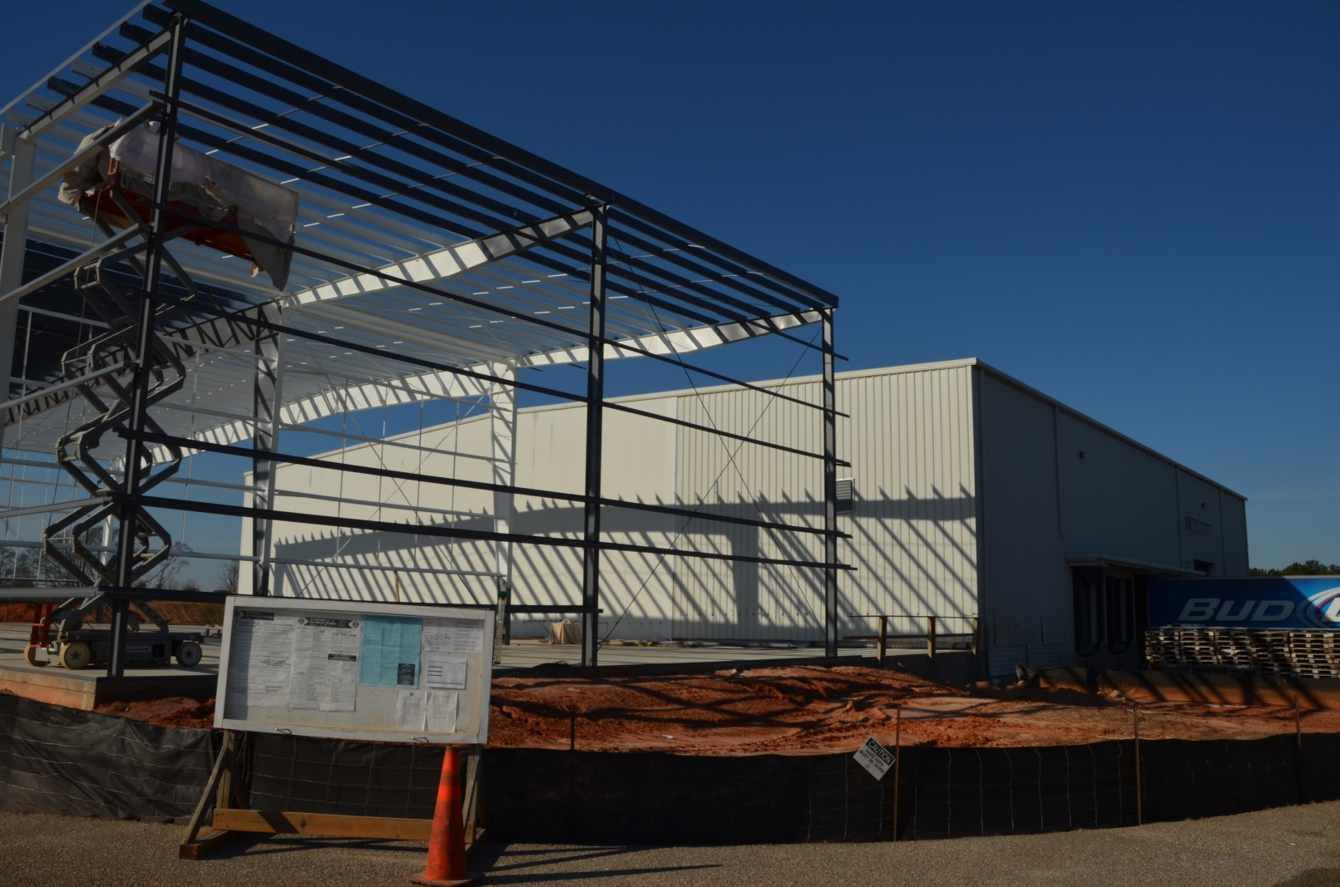
South Alabama EC
Troy Industrial Development Board
Horn Beverage Company

Slide 12
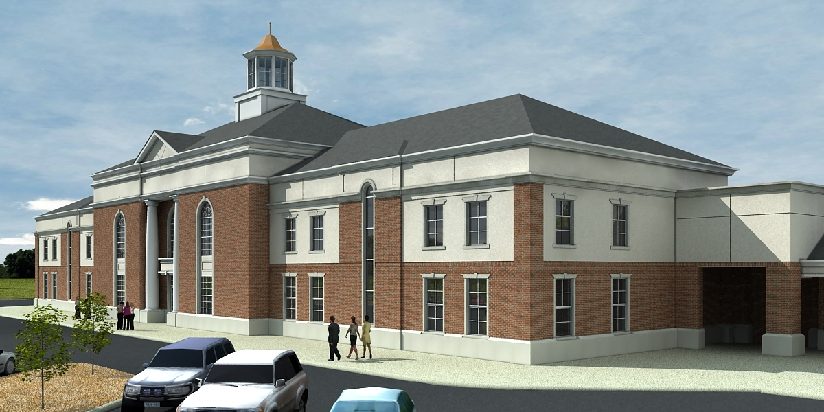
South Alabama EC
Troy Industrial Development Board
CGI Technologies

Slide 13
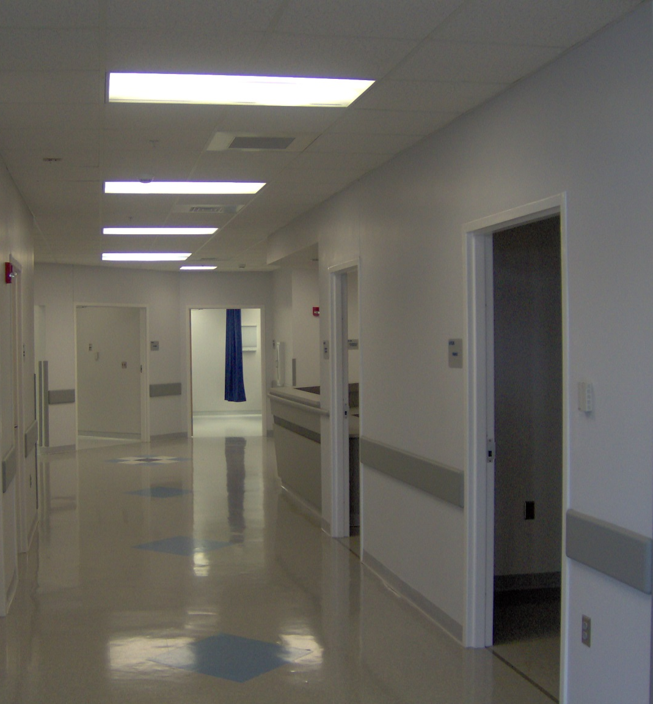
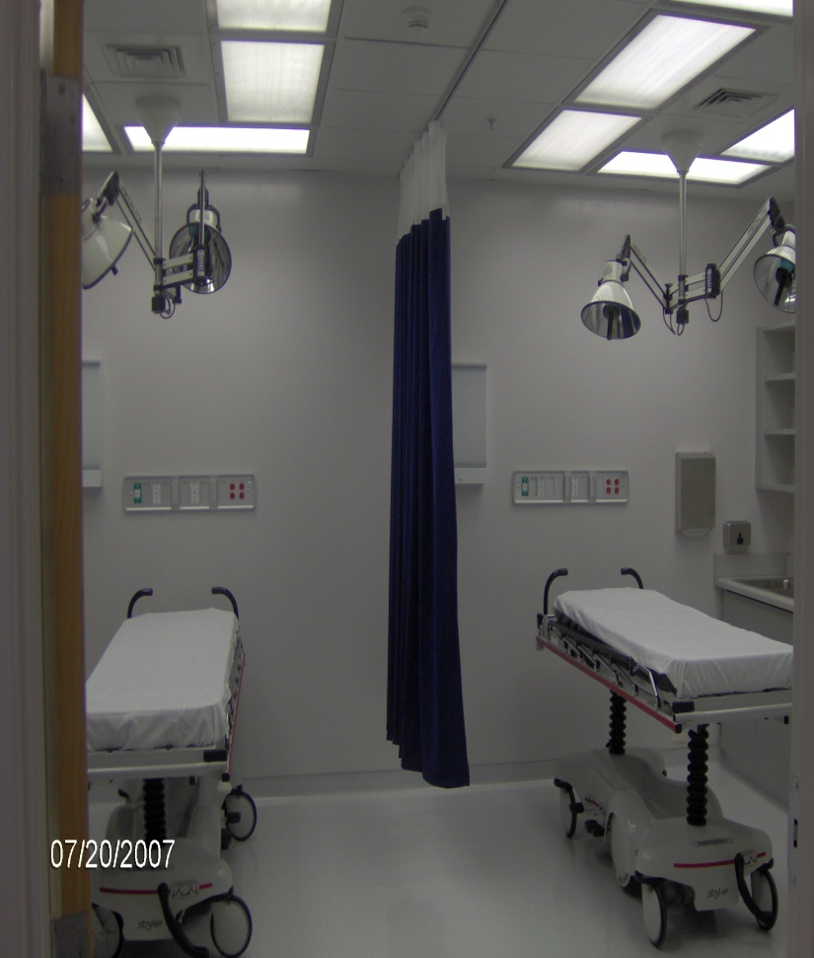
South Alabama EC
Crenshaw County Healthcare Authority

Slide 14
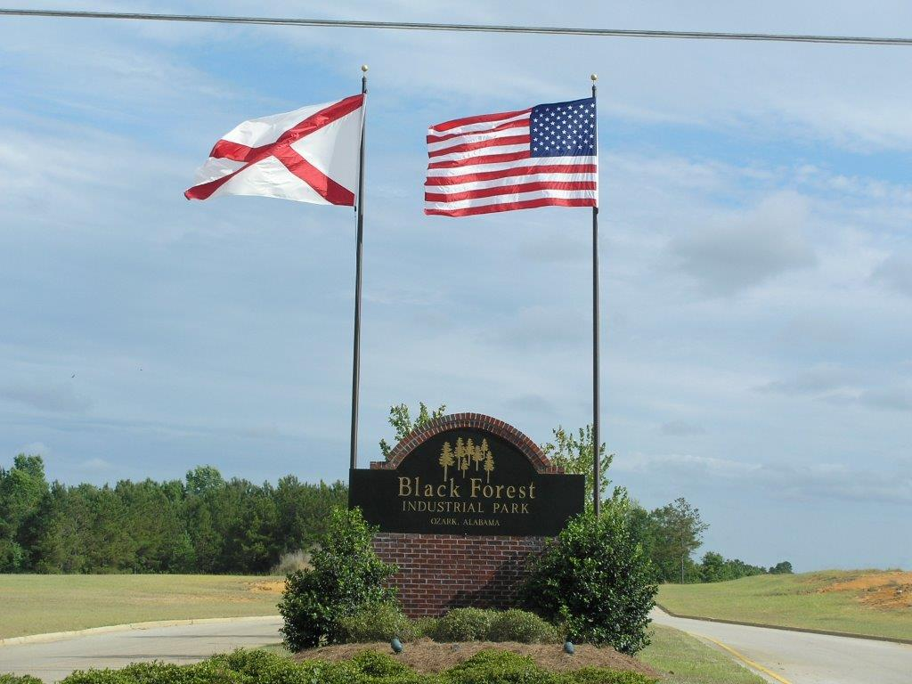
Pea River EC
Black Forest Industrial Park – City of Ozark

Slide 15
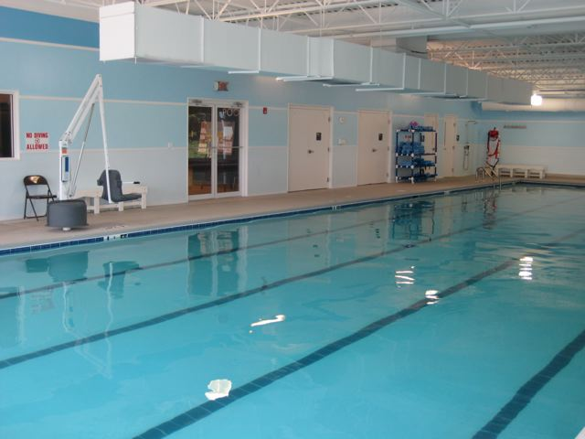
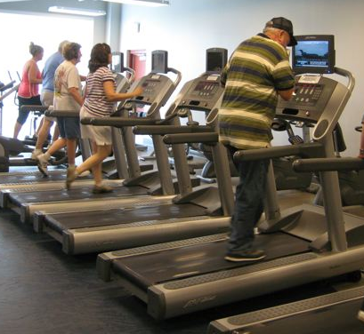
PowerSouth Energy Cooperative
Mizell Memorial Hospital
Wellness Center

Slide 16
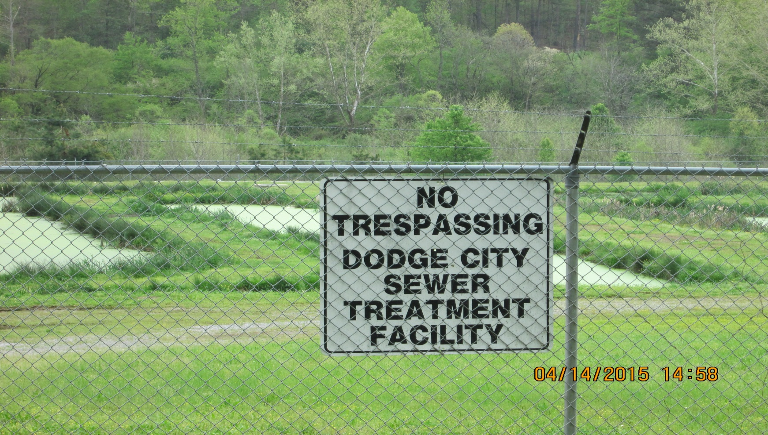
Cullman EC
Town of Dodge City

Slide 17
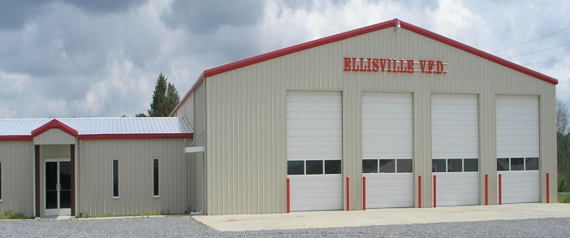
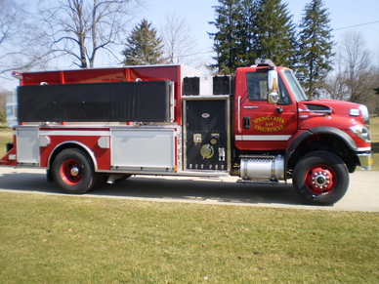
Cherokee EC
Volunteer Fire Departments

Slide 18
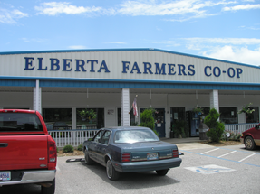
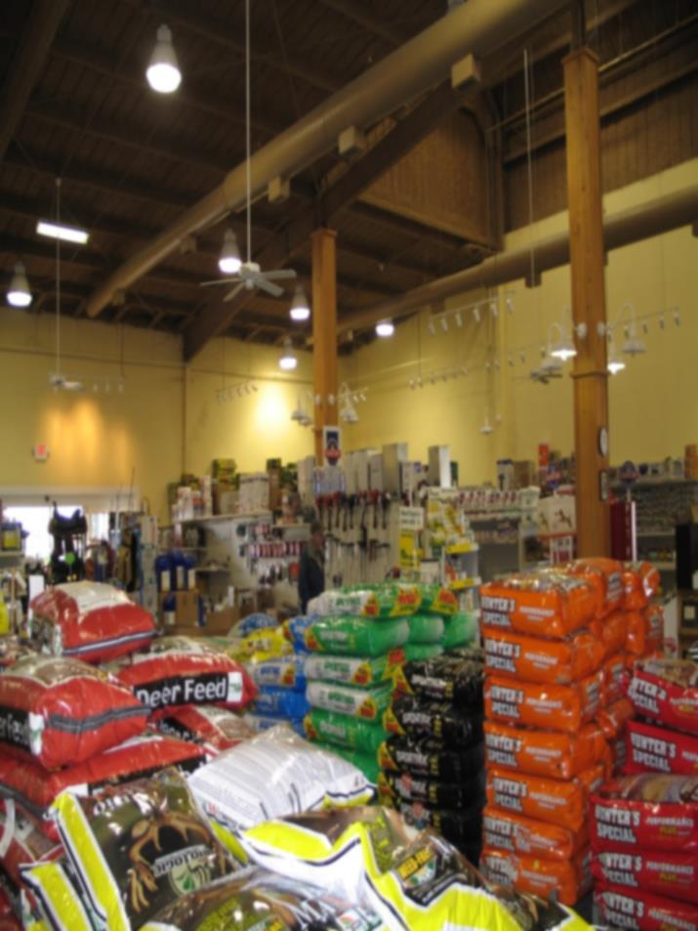
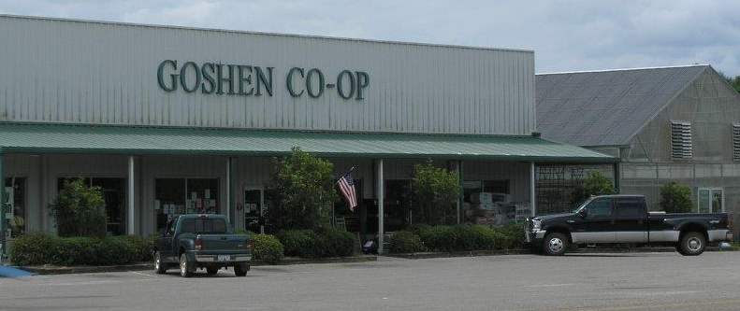
Farmers Cooperatives
Elberta (Baldwin) Goshen (SAEC) Selma (Pioneer)

Slide 19
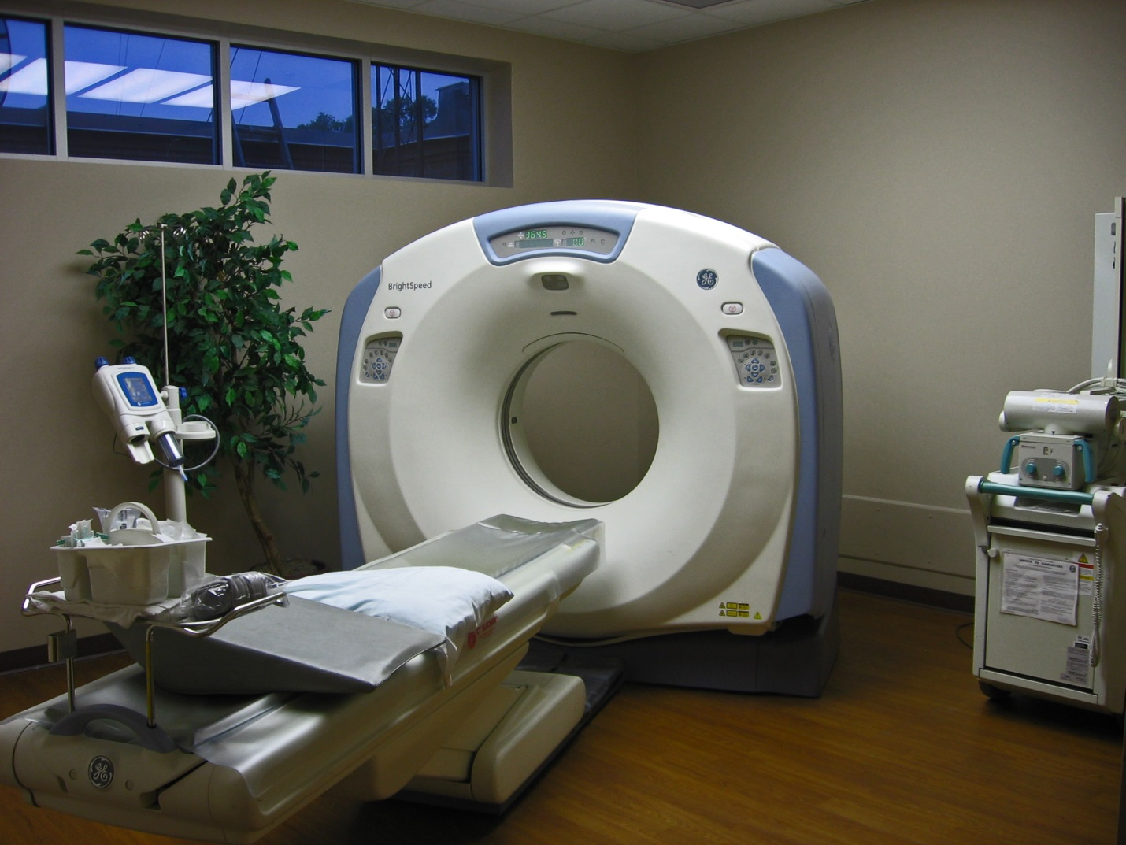
Clarke-Washington EMC
CT Scanner for the Clarke-Washington Hospital

Slide 20
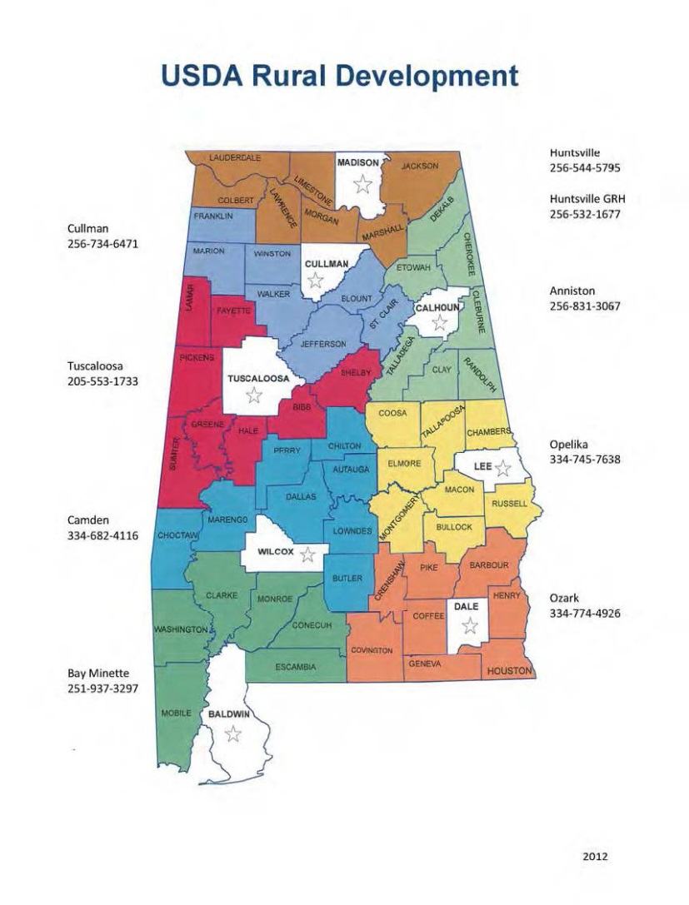

USDA
Rural Development
www.rd.usda.gov
Opelika moved to
Tuskegee
Application submissions—unlimited
Multiple awards allowable to same cooperative

Slide 21
Rural Economic Development
Loan and Grant Program
REDLG

